Slide 1
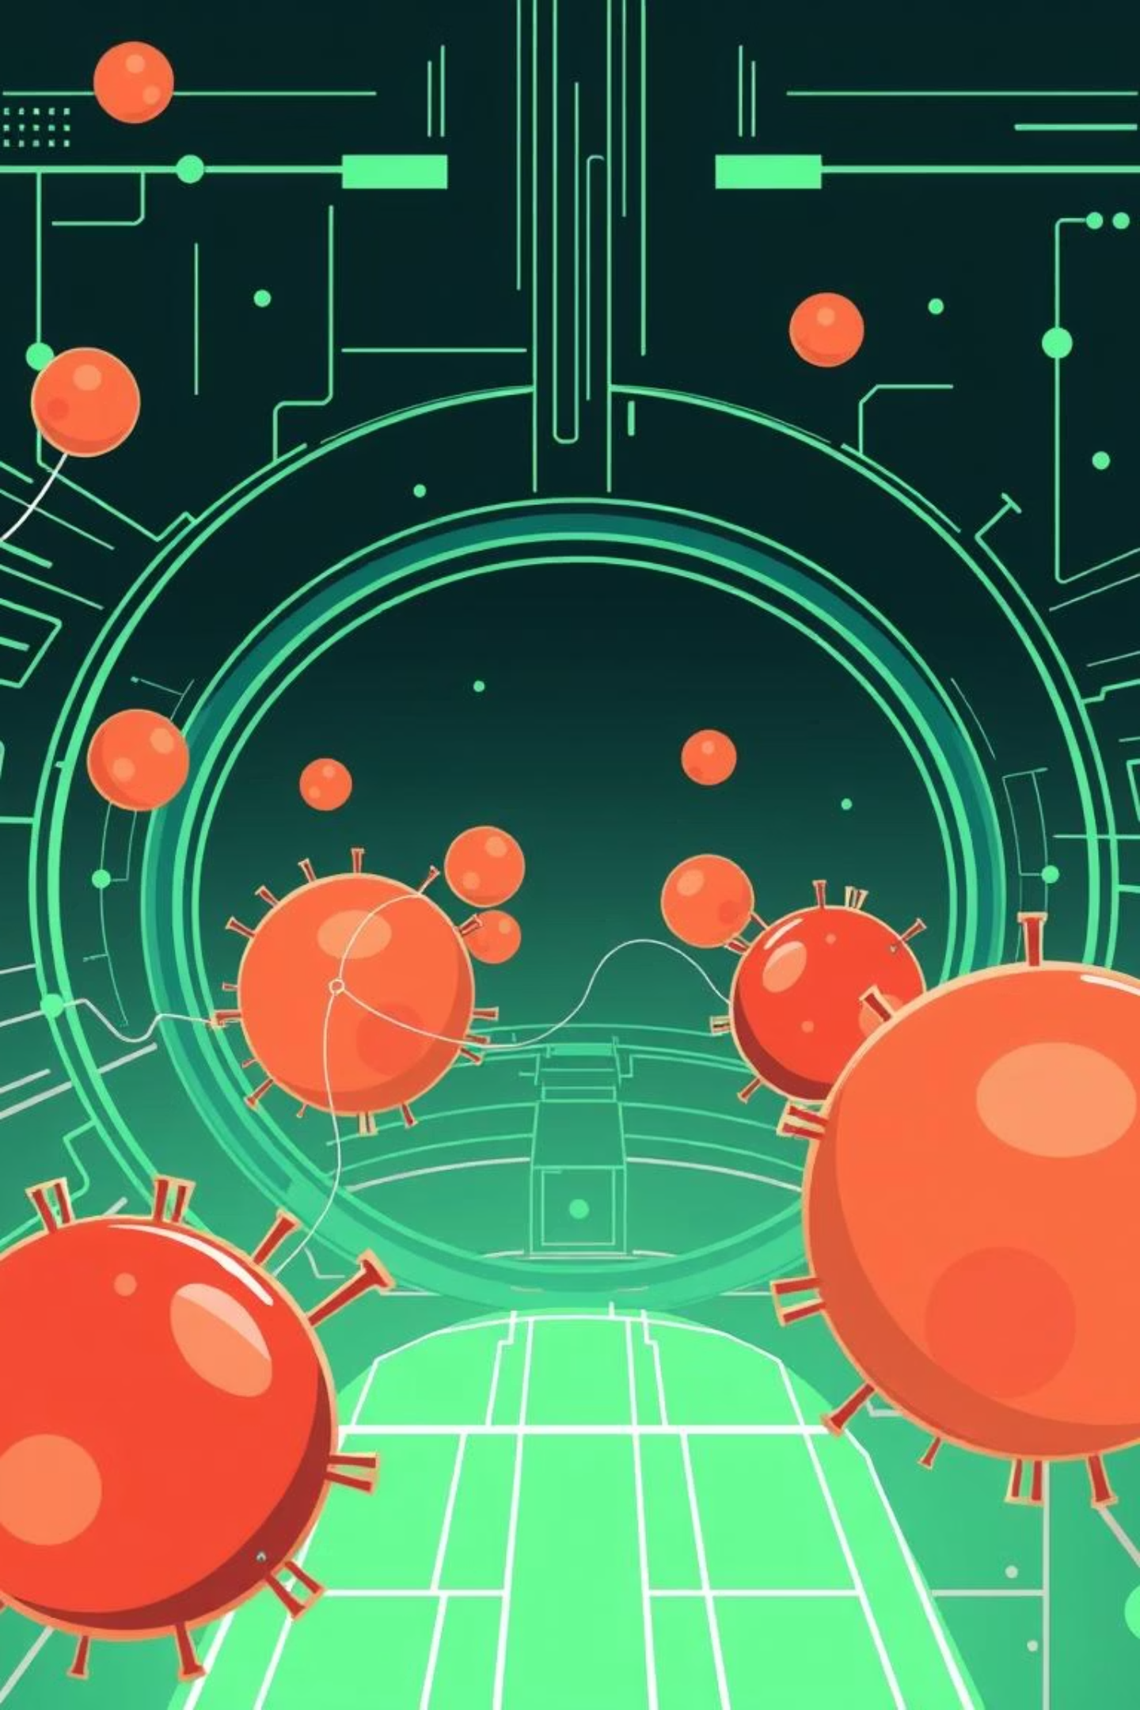
Thala Connect AI: Revolutionizing Blood Coordination
Welcome to our pitch for Thala Connect AI, an innovative AI-powered blood coordination platform designed to transform blood accessibility for Thalassemia patients. Built for the Blood Warriors Hackathon, our solution aims to address critical challenges in donor matching and patient support.

Slide 2
The Challenge: Delays and Disconnects
Access Delays
Manual Matching
No Predictive System
Thalassemia patients face critical delays in accessing compatible blood.
Current manual donor matching lacks speed and reliability.
Absence of a predictive system for donor availability.
Limited Education
Human Dependency
Insufficient patient education in native languages.
Existing solutions rely heavily on human coordination.

Slide 3





Thala Connect AI: Our Solution
Thala Connect AI is a web and WhatsApp platform designed to streamline blood coordination.
Real-time Matching
Emergency Alerts
Predictive Patterns
AI matches patients with donors instantly.
Sends WhatsApp emergency alerts to donors.
Predicts donor engagement and availability.
Multilingual Education
e-RaktKosh Integration
Provides support and education in various languages.
Enhances national coverage by integrating with e-RaktKosh.
Our uniqueness lies in expanding Blood Bridge into a predictive, automated national network.

Slide 4
Technology Stack
Frontend
React (Vite) + Tailwind CSS
UI/UX
Shadcn UI + Headless UI
Backend
Lovable-generated APIs + custom endpoints
Chatbot (Text + Voice)
OpenAI GPT + Azure Speech SDK
Authentication
Firebase Authentication
Database
Azure SQL Database
Hosting
Azure App Service
Crowdfunding
Stripe Integration
Notifications
Twilio WhatsApp API + Azure Notification Hubs
Analytics & Reports
Power BI
Multilingual Hub
GPT + Azure Translator API + i18n

Slide 5






Key Functionality
AI Chatbot
Emergency Requests
Auto-matching, voice input, multilingual replies via Web + WhatsApp.
Instant alerts to nearby donors via WhatsApp.
Role-Based Flows
Gamified Donor Experience
Interfaces for Donor, Patient, Admin, and Doctor.
Badges, donation history, and impact scores.
Education Hub
Community Support
Available in 6+ languages for comprehensive patient awareness.
NGO partnerships and integrated chat support.

Slide 6
Expected Impact
1
Faster Response Time
2
Predictive Donor Behavior Modeling
3
Reduced Burden on Blood Warriors
4
Improved Patient Awareness
5
Gamified Donor Incentives
6
Nationwide Scalability of Blood Bridge

Slide 7
Challenges & Mitigations
Donor drop-off
Predictive nudges + gamification
API access limitations
Fallback to SMS & direct alerts
Data privacy & compliance
Firebase Auth + Azure SQL security
Voice bot complexity
Azure Speech SDK with text fallback
Rural tech access
Lightweight UI, vernacular content, offline mode

Slide 8
Key Assumptions
User Access
Platform Stability
NGO Support
Most users have smartphones and WhatsApp.
Firebase + Azure remain accessible and reliable.
NGOs will support digital onboarding efforts.
Payment Integration
Chatbot Guidance
Stripe works effectively for local crowdfunding.
GPT chatbot adheres to guidance, avoiding medical diagnosis.

Slide 9
Project Timeline
Hackathon MVP
Month 1–2
Web + WhatsApp Chatbot MVP Donor Match FlowRole-based Dashboards
Crowdfunding + e-RaktKosh API mock integration
1
2
3
4
Week 1–2
Month 3+
Leaderboard, impact tracking, full multilingual content
District-level pilot with Blood Warriors + Voice Bot Launch

Slide 10

Thank You!
We believe Thala Connect AI will significantly improve blood coordination for Thalassemia patients.
Questions?

